Slide 1
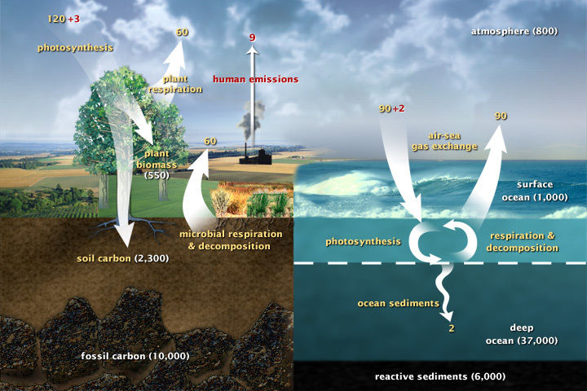
Carbon fluxes in Earth’s climate system (2003)
(about 377 ppm CO2)
Today, we’ll talk about two CGI assignments:
ScheduledFlows
CumulativeAnalysis

Slide 2
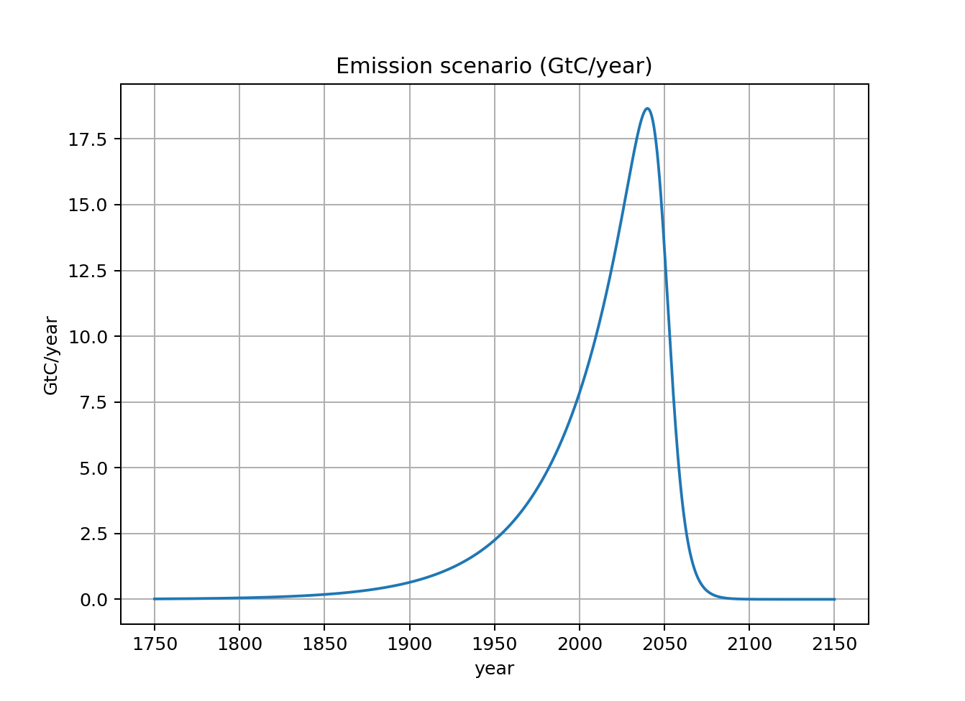
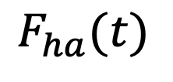
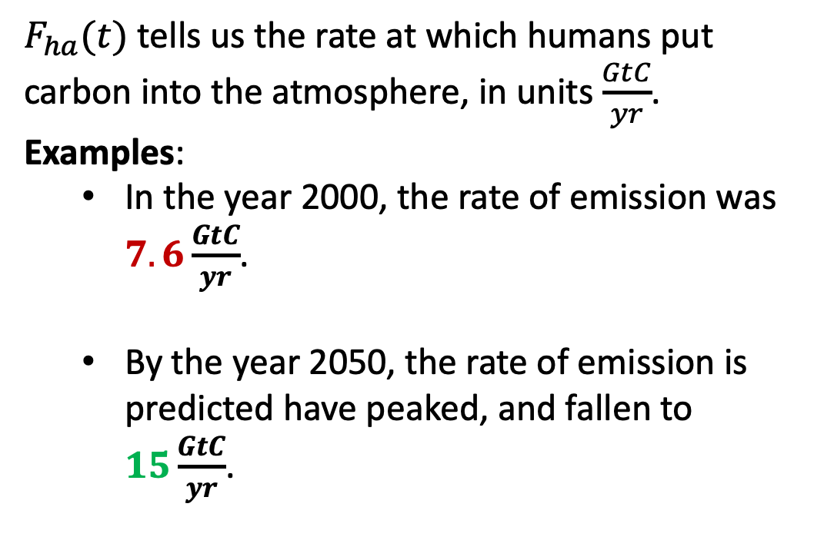
1. ScheduledFlows – Meaning and units
$F_{ha}(t)$ tells us the rate at which humans put carbon into the atmosphere, in units $\frac{GtC}{yr}$.
Examples:
In the year 2000, the rate of emission was $7.6\frac{GtC}{yr}$.
By the year 2050, the rate of emission is predicted have peaked, and fallen to $15\frac{GtC}{yr}$.
$$F_{ha}(t)$$

Slide 3
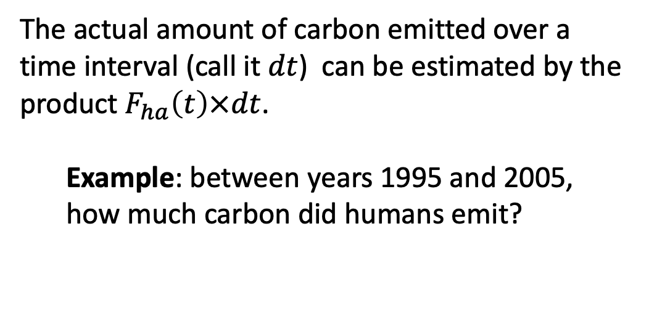
Estimating an amount of carbon over a given time interval
The actual amount of carbon emitted over a time interval (call it $dt$) can be estimated by the product $F_{ha}\left(t\right)×dt$.
Example: between years 1995 and 2005, how much carbon did humans emit?
$$F_{ha}(t)$$

Slide 4
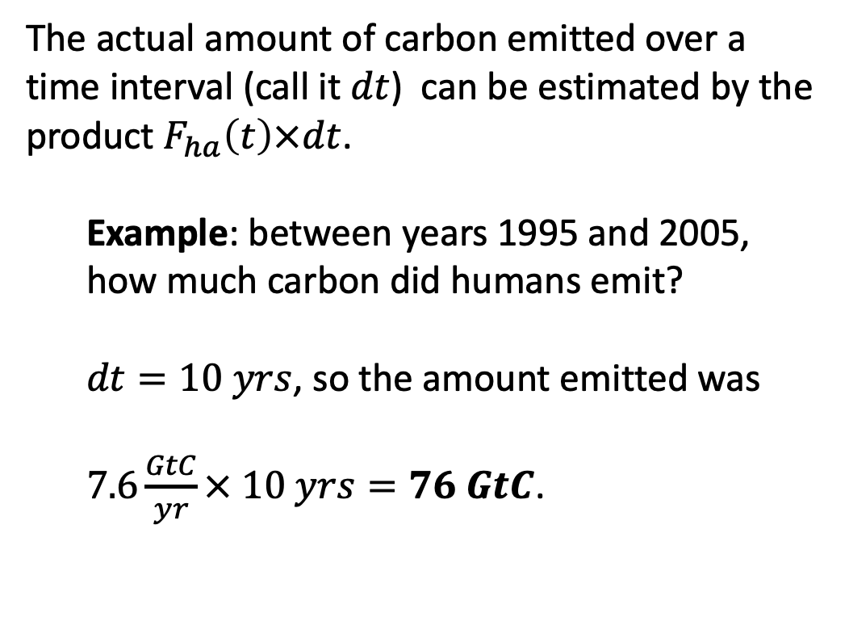
Estimating an amount of carbon over a given time interval
The actual amount of carbon emitted over a time interval (call it $dt$) can be estimated by the product $F_{ha}\left(t\right)×dt$.
Example: between years 1995 and 2005, how much carbon did humans emit?
$dt=10 yrs$, so the amount emitted was
$7.6\frac{GtC}{yr}× 10 yrs=76 GtC$.
$$F_{ha}(t)$$

Slide 5
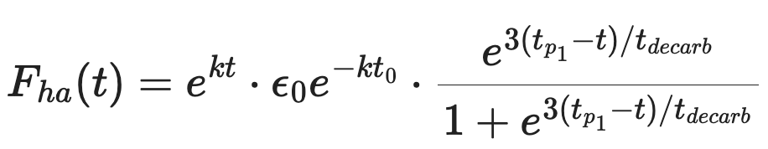
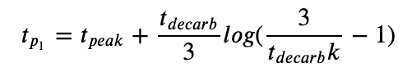
Mathematical form of $F_{ha}\left(t\right)$

Slide 6
Mathematical form of $F_{ha}\left(t\right)$ – The pre-peak exponential growth
This is the exponential growth part

Slide 7

Mathematical form of $F_{ha}\left(t\right)$ – Getting it right at one known time
This is the “pegged” value
Example: $t_{o}=2000$, $ε_{o}=7.6\frac{GtC}{yr}$

Slide 8

Mathematical form of $F_{ha}\left(t\right)$ – Specifying the year of maximum emission
This term specifies the year of maximum emission
$$t_{peak}=2040$$

Slide 9

Mathematical form of $F_{ha}\left(t\right)$ – Specifying the year of maximum emission
This term specifies a decarbonization time according to the “80/20” rule
$$t_{decarb}=15 years$$

Slide 10
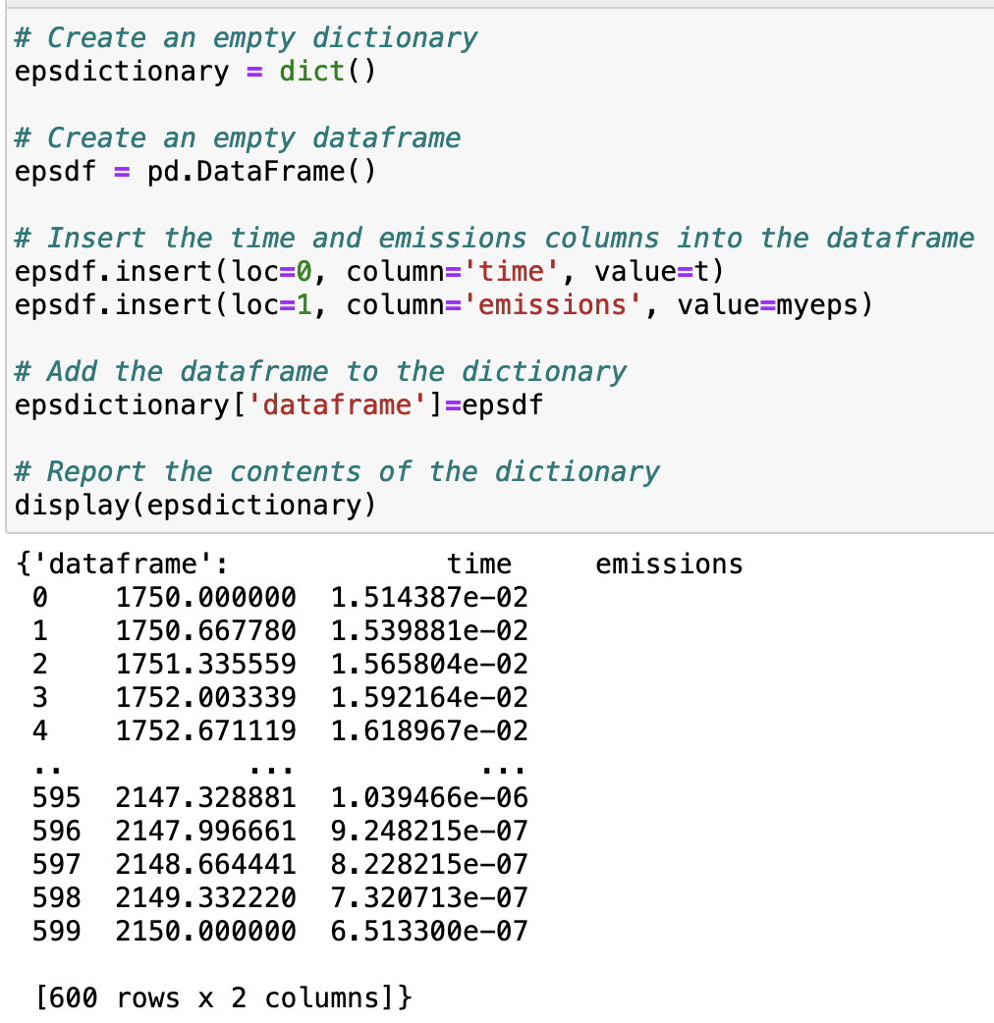
Metadata associated with $F_{ha}\left(t\right)$
Part of good coding practice is finding ways to save data in a way that is "self-documenting." Like, including the units of your data, or other parameters.
Fortunately, with a combination of Python's Pandas package, and a built-in Python feature called dictionaries, we can do all that.

Slide 11
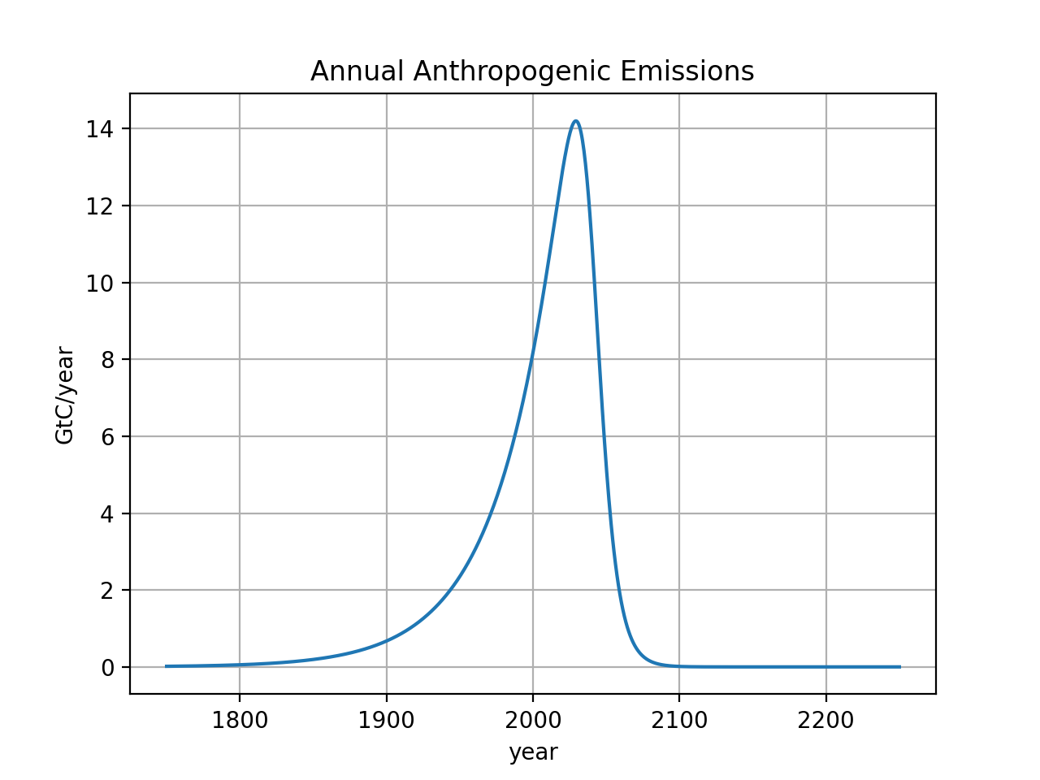
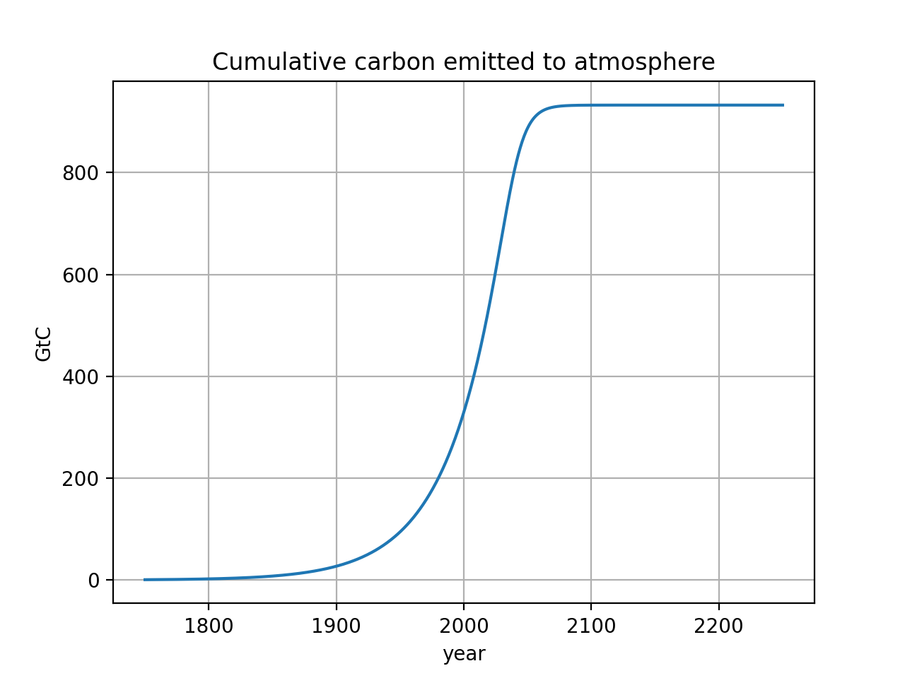



2. CumulativeAnalysis – The total carbon emissions accumulated over time, $E(t)$
$F_{ha}(t)$
Sometimes we want to know the total accumulated human emissions up to a certain time. We’ll call this $E(t)$.
$E(t)$
Notes:
http://www.igbp.net/news/features/features/havewereachedpeakco2.5.1b8ae20512db692f2a680003465.html

Slide 12
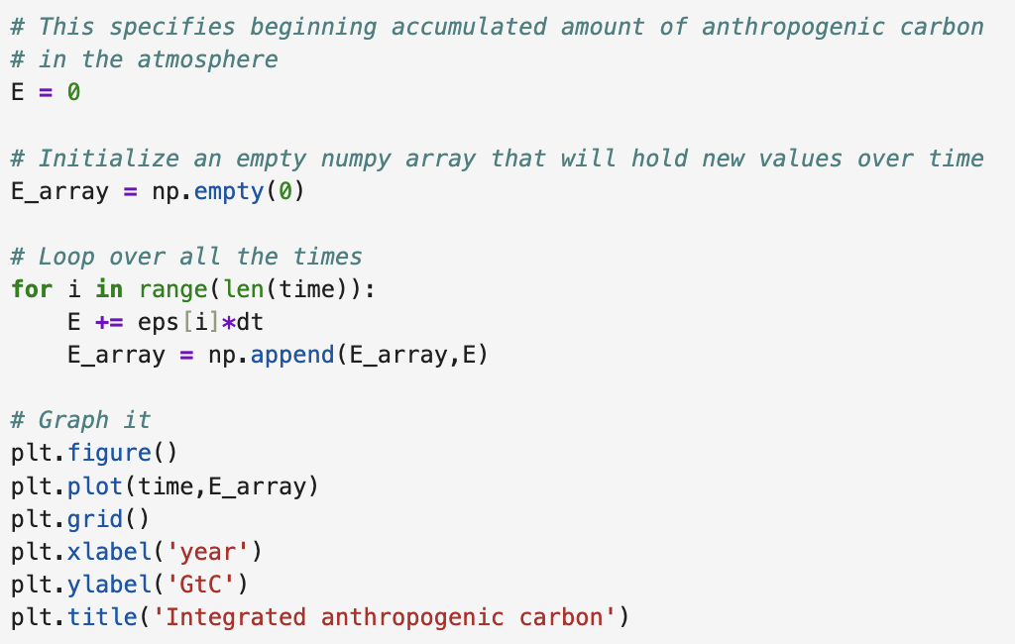
Getting $E(t)$ using a Python loop
$F_{ha}(t)$
$E(t)$
Notes:
http://www.igbp.net/news/features/features/havewereachedpeakco2.5.1b8ae20512db692f2a680003465.html

Slide 13
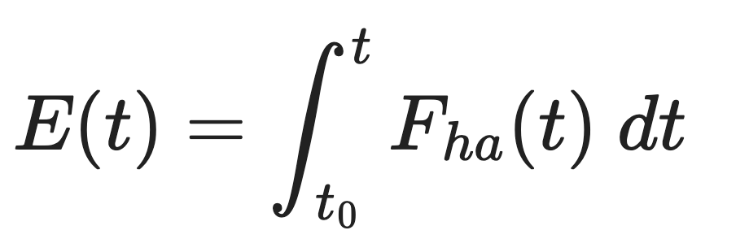
Getting $E(t)$ with calculus (DO NOT worry about this, it’s just for the Math 181 veterans)
$F_{ha}(t)$
$E(t)$
Notes:
http://www.igbp.net/news/features/features/havewereachedpeakco2.5.1b8ae20512db692f2a680003465.html

Slide 14
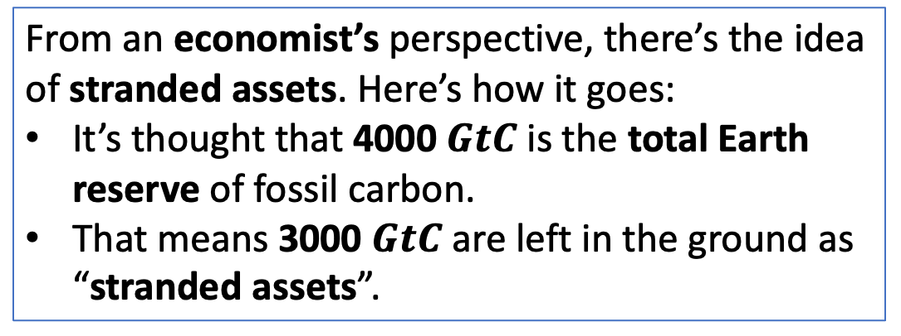
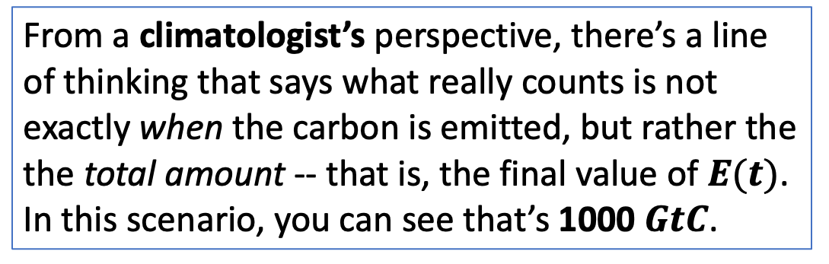
Difference between a climatologist’s perspective and a economist’s perspective on $E(t)$
From a climatologist’s perspective, there’s a line of thinking that says what really counts is not exactly when the carbon is emitted, but rather the the total amount -- that is, the final value of $E(t)$. In this scenario, you can see that’s 1000 $GtC$.
From an economist’s perspective, there’s the idea of stranded assets. Here’s how it goes:
It’s thought that 4000 $GtC$ is the total Earth reserve of fossil carbon.
That means 3000 $GtC$ are left in the ground as “stranded assets”.
Notes:
http://www.igbp.net/news/features/features/havewereachedpeakco2.5.1b8ae20512db692f2a680003465.html

Slide 15
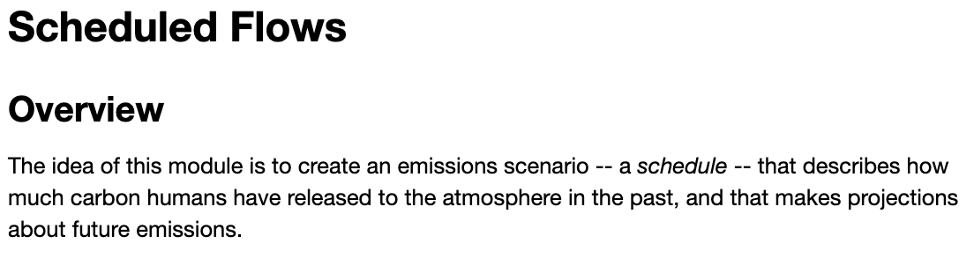
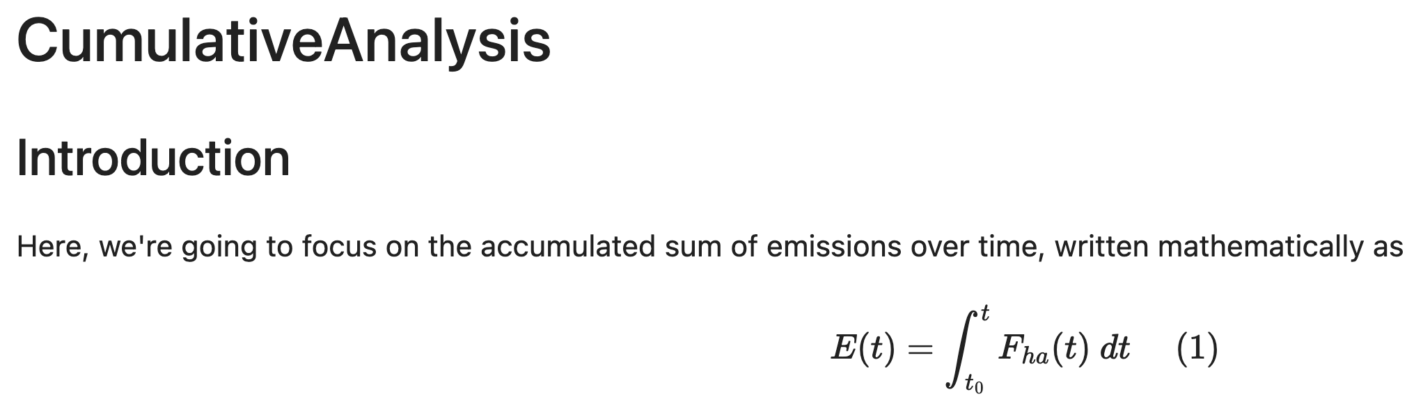
OK, let’s get started!
Notes:
Predict the temperature if CO2 continues to rise. If we reduce CO2 emissions to zero.

